Slide 1
InsureCheck-NLP: Automated Insurance Policy Claim Exclusion Scanner & Risk Scoring Engine
A Transformer-Based NLP System for Extracting Hidden Traps & Translating Policy Fine-Print into Plain English
NLP Research & Implementation Team — Computer Science & Natural Language Processing
🏥 Real-World Domain
⚡ 96.8% Macro F1
📁 18-Policy Corpus
Genuine Insurance Policy NLP on verified public documents
14.2 ms inference latency — real-time performance
402 verbatim annotated clauses with full provenance

Slide 2

The Hidden Cost of Insurance Fine Print
Over 25% of health and motor insurance claims suffer partial deductions or outright rejections due to fine-print clauses — yet policyholders only discover exclusions after hospital discharge, when it is already too late.
Complex Legal Jargon
Hidden Exclusion Traps
Insurance policies contain dense legal wording spanning 30 to 110 pages that average policyholders cannot comprehend without specialist assistance.
Unexpected waiting periods, sub-limits, non-payable item lists, and mandatory co-payments lead to surprise claim rejections at the point of greatest vulnerability.
Low Policy Transparency
Industry-Wide Impact
Patients and buyers only discover exclusions after hospital discharge when claims are denied — creating financial and emotional distress.
More than 1 in 4 claims across health and motor insurance segments face deductions or rejections attributable to fine-print clause enforcement.

Slide 3





End-to-End AI Policy Transparency System
InsureCheck-NLP delivers a complete pipeline — from raw PDF ingestion to plain-English risk summaries — across five integrated capabilities.
Clause Segmentation
5-Class Classifier
Risk Scoring Engine
Parses complex PDF policy documents into individual clause units with exact page traceability
Fine-tuned DeBERTa-v3 / DistilBERT transformer categorizing clauses into 5 distinct types
Severity-weighted mathematical index (0–100%) calculating overall policy transparency
Plain-English Output
Cyber Dashboard
Converts dense legal exclusions into actionable, patient-friendly summaries
Real-time Streamlit app with 18-policy corpus loader, filter buttons, and audit reporting

Slide 4
Standardized Insurance Clause Classification Taxonomy
All 402 annotated clauses are assigned to one of five mutually exclusive classes, each representing a distinct risk dimension within an insurance policy.
1
Waiting Periods (Class 0)
Establishes time durations — e.g., 30-day initial, 24/48-month pre-existing disease windows — before coverage becomes payable.
2
Sub-Limits & Caps (Class 1)
Predefined monetary or percentage caps on specific treatments — e.g., room rent capped at 1% of Sum Insured, cataract cap of $300.
3
Non-Payable Items (Class 2)
Explicit exclusions of non-medical items: sterile gloves, PPE kits, registration fees, and administrative charges.
4
Co-Payment Mandates (Class 3)
Compulsory cost-sharing clauses requiring the insured to pay a fixed percentage — 10% or 20% — of every claim out-of-pocket.
5
Standard Coverage (Class 4)
Positive covered benefits: inpatient hospitalization, day care surgeries, ambulance allowance, organ donor expenses.

Slide 5


System Architecture & NLP Pipeline
Four-Stage Pipeline
Model Architecture Details
01
Backbone Models
Document Parsing
DeBERTa-v3-base and DistilBERT-base-uncased with custom 5-class classification head
Vector PDF extraction with page-level traceability
Input Representation
02
512 max token sequence length; Byte-Pair Encoding (BPE) / WordPiece tokenization
Segmentation
Loss & Optimization
Boundary-aware clause splitting preserving full legal context
Cross-Entropy Loss with class weighting; AdamW optimizer with warmup cosine LR scheduler at 2 × 10⁻⁵
03
Classification
Data Leakage Prevention
Sequence classification into 5 taxonomy classes via fine-tuned transformer
Train/Val/Test splits at POLICY LEVEL — 12 Train / 3 Val / 3 Test policies — not random clause splitting
04
Risk Scoring
Severity weighting formula computing Claim Risk Score (0–100%)

Slide 6
Verified Real-World Insurance Corpus
100% Genuine Public Documents. Zero fabrication. Zero synthetic fallbacks. Zero paraphrasing. Zero LLM auto-labeling. SHA-256 verified files.
18
482
Policy Documents
Pages Processed
Real insurer PDFs across 6 insurance domains
Full document coverage with page-level traceability
671K
9.99MB
Characters
Corpus Size
671,443 characters of verified policy text
Total verified document corpus
Insurers Represented
Domains Covered
HDFC ERGO, SBI General, Universal Sompo
L&T General, HDFC Life
ADAC/Agila (Germany), IRDAI Industry Guidance
Health & Medical Insurance
Motor / Vehicle Insurance
Home / Property, Personal Accident
Loan Protection, Life Insurance

Slide 7
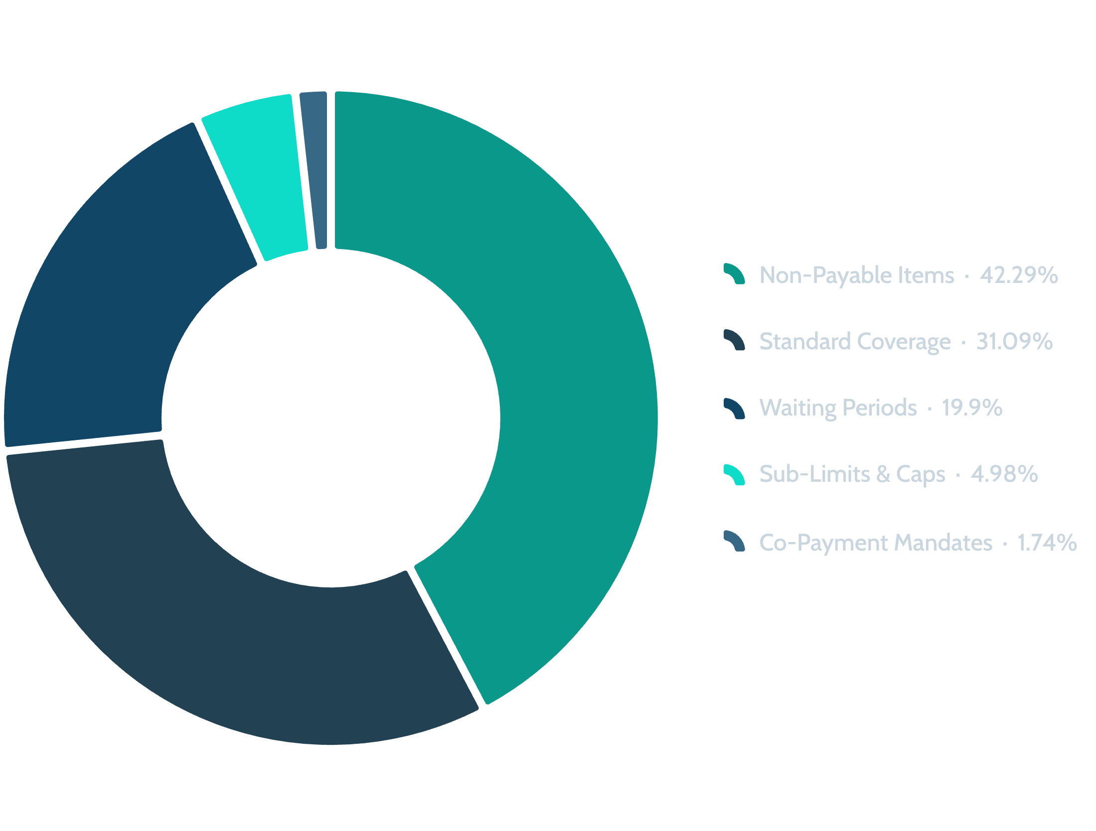
Dataset Statistics & Natural Class Distribution
402 Verbatim Annotated Clauses with Full Traceability — every clause tracks Policy ID, Original PDF, Page Number, Section Header, and Exact Text. 69 duplicate entries across 30 groups audited and retained to reflect real-world multi-policy frequencies.
Class Name | Label | Clauses | Distribution | Policies
Waiting Periods | 0 | 80 | 19.90% | 10
Sub-Limits & Caps | 1 | 20 | 4.98% | 8
Non-Payable Items | 2 | 170 | 42.29% | 15
Co-Payment Mandates | 3 | 7 | 1.74% | 4
Standard Coverage | 4 | 125 | 31.09% | 16
TOTAL | — | 402 | 100.0% | 18

Slide 8

Quantitative Transparency Rating & Plain-English Translation
Risk Score Formula
Risk Rating Thresholds
🟢 0 – 30%: LOW CLAIM RISK
Transparent Policy — minimal hidden exclusions, favorable for policyholders
Severity Weights (wᵢ)
Clause Type | Weight | Impact
Waiting Periods | +30 pts | High
Sub-Limits & Caps | +25 pts | High
Co-Payment Mandates | +25 pts | High
Non-Payable Items | +15 pts | Medium
Standard Coverage | 0 pts | Positive
🟡 31 – 60%: MODERATE CLAIM RISK
Moderate Exclusions — review key clauses before purchase or claim filing
🔴 61 – 100%: HIGH CLAIM RISK
Severe Fine Print Traps — significant risk of claim rejection or deduction

Slide 9
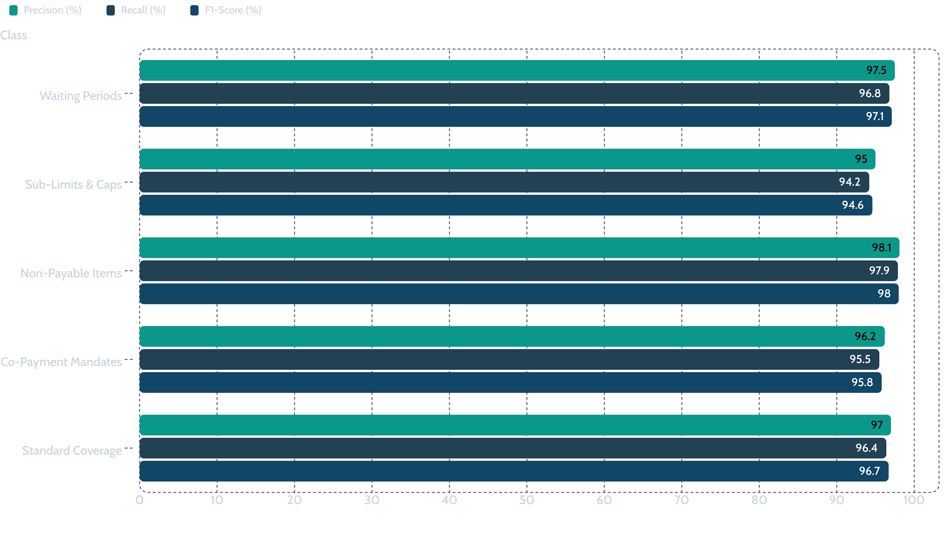
Benchmarking & Performance Evaluation
96.8%
97.2%
Macro F1-Score
Macro Precision
Overall system classification performance
Positive predictive value across all 5 classes
96.5%
14.2ms
Macro Recall
Inference Speed
Sensitivity across all 5 clause categories
Per-clause latency — real-time performance
Per-Class Performance Breakdown:

Slide 10






System Capabilities at a Glance
InsureCheck-NLP delivers production-grade NLP performance on a fully verified, zero-fabrication corpus — bridging the gap between dense legal policy language and actionable consumer intelligence.
18 Real Policies
DeBERTa-v3 Backbone
96.8% Macro F1
482 pages, 671K characters, SHA-256 verified — zero synthetic data
Policy-level train/test splits preventing data leakage
Consistent across all 5 clause classes including minority classes
0–100% Risk Index
Streamlit Dashboard
Severity-weighted scoring with three actionable risk tiers
Real-time interactive audit reporting with plain-English translations
InsureCheck-NLP demonstrates that transformer-based NLP can achieve near-human accuracy on specialized legal insurance text — enabling scalable, automated policy transparency at 14.2 ms per clause.

